Slide 1

Smart ADC Monitoring and Logging System
Team Member:
1.Sanjay
2.Pratiksha Kale
3.Munilakshmi

Slide 2
Introduction:
The Smart ADC Monitoring and Logging System is a real-time data acquisition project that focuses on reading analog input through an ADC (Analog-to-Digital Converter), displaying the results on an LCD, and logging the conversion data through USART communication for debugging and analysis.
The system reads an analog signal, converts it into a digital value using the onboard ADC, and displays this data on a 16x2 LCD screen. Additionally, it sends detailed logs of each conversion step through USART, allowing for remote monitoring and feedback.

Slide 3
Problem Statement:
Detect fraudulent financial transactions in real-time by identifying unusual patterns such as high transaction amounts, new devices, unusual locations, and non-business hour activities, using transaction profiling, rule-based detection, and risk scoring.

Slide 4
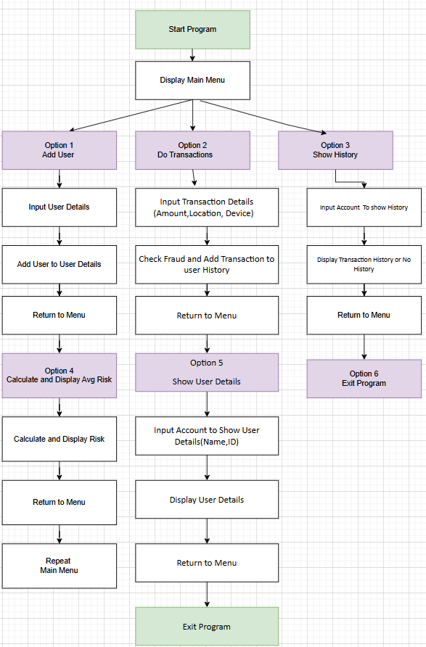
Flowchart:

Slide 5
Algorithm:
Start
Initialize users map
Loop until user exits:
Display Main Menu
Input user choice
Case 1: Add new user
Input user details
Store user in map
Case 2: Process transaction
Input user details
Verify user existence in map
Input transaction details (amount, location, device)
Get current time
Check for fraud (Amount, Location, Device, Time)
If flagged, abort transaction
Else, accept and log transaction
Case 3: Show transaction history
Input account number
Display user’s transaction history
Case 4: Calculate average risk
Input account number
Calculate and display average risk
Case 5: Show user details
Input account number
Display user details (name, account number, bank)
Case 6: Exit
Exit the loop
End Loop
End

Slide 6
Functional Requirements:
1.Transaction Profiling:
Maintain a historical record of user transactions (amount, location, time, device).
Enable real-time retrieval of transaction history for fraud analysis.
2. Rule-based Fraud Detection:
Implement rules to flag suspicious transactions based on predefined criteria (e.g., amount, device, location, time).
Support dynamic updating of rules by administrators.
3. Transaction Scoring:
Assign a fraud risk score to each transaction based on its characteristics.
Store flagged transactions with risk scores for prioritization.
4. Alerts and Notifications:
Generate alerts for flagged transactions.
Send notifications to relevant parties (e.g., user, fraud analyst) for further action.
5. Real-time Processing:
Process incoming transactions in real-time to detect fraud immediately.
6. User Management:
Manage user profiles, including device and location history.
Allow manual input of suspicious transactions by analysts.

Slide 7
Non-Functional Requirements:
1.Performance:
Ensure the system can process transactions within 1 second for real-time detection.
2.Scalability:
Handle high transaction volumes during peak times without performance degradation.
3.Accuracy:
Minimize false positives and false negatives in fraud detection.
4.Security:
Protect sensitive transaction data with encryption and secure access controls.
Ensure compliance with relevant financial regulations and standards .

Slide 8
Time Complexity:
Add New User: O(logn)
Transaction Processing: O(m)
Show Transaction History: O(m)
Calculate Average Risk: O(m)
Show User Details: O(1)
Space Complexity: O(n×m),
where n is the number of users and
m is the average number of transactions per user.

Slide 9
APPLICATION:
Banking Sector:
Detect fraudulent activities in credit card and debit card transactions.
Monitor wire transfers for unusual patterns or amounts.
Identify unauthorized access to online banking accounts.
E-commerce:
Flag suspicious transactions in online purchases, such as high-value orders or transactions from new devices.
Prevent payment fraud by identifying discrepancies in user profiles and behavior.
Insurance:
Identify fraudulent claims by analyzing patterns of payouts and claim requests.
Flag transactions linked to unusual locations or accounts.
Health Sector:
Identify fraud in health insurance transactions or claims.
Detect animalies in payments for medical sevices or prescriptions.

Slide 10
Future Scope:
Integration of Advanced AI/ML Techniques:
Implement machine learning models to enhance fraud detection accuracy by learning complex patterns and behaviors over time.
Use anomaly detection algorithms to identify previously unknown fraud patterns.
Dynamic Rule Updates:
Develop self-adjusting rules that adapt to evolving fraud trends based on real-time data and feedback.
Allow predictive analysis to preempt emerging fraud techniques.
Real-time Decisioning and Automation:
Implement systems for automated real-time blocking of suspicious transactions while ensuring legitimate transactions are processed seamlessly.
Use robotic process automation (RPA) to streamline investigation workflows.

Slide 11
Conclusion:
The fraud detection system efficiently identifies and flags suspicious financial transactions in real-time, ensuring security and reliability. With scalable architecture and future-ready enhancements, it strengthens fraud prevention across industries, fostering trust in digital financial systems.

Slide 12
THANK YOU

